Slide 1
HEALTH INSURANCE MARKET PLACE
RANDALL CAMPBELL & KALYANA S NANDURI

Slide 2
INTRODUCTION
Health insurance policies issued by private insurers and/or publicly-funded health programs, such as cost of medical treatments.
The U.S. insurance industry’s net premiums written totaled $1.2 trillion in 2015, with premiums recorded by life/health (L/H) insurers accounting for 55 percent and premiums by property/casualty (P/C) insurers accounting for 45 percent, according to S&P Global Market Intelligence.

Slide 3
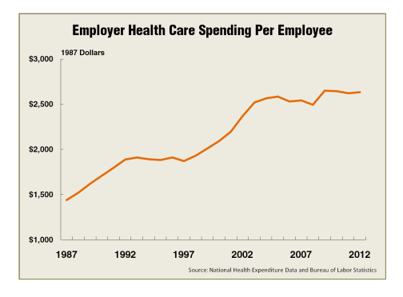
INTERESTING FACTS

Slide 4
OBJECTIVE
Our primary research is to determine the following:
Which healthcare plan benefit(s) and attribute(s) have the most impact on monthly premiums?
Which states provide healthcare plans with the lowest cost and most benefits?
Which plan benefit or attribute has the most impact on individual rate?
Formulate a minimum of three common benefit and plan attribute profiles.

Slide 5
DATA SET – CHALLENGES
Extremely large and complex data set with multiple fields.
Limited understanding of the unhealthy population subject only to historical medical information.
Model was heavily dependent on historical medical history.

Slide 6
DATA SET – CLEAN / TRANSFORM / MERGE
Used different csv's and merge them together.
After extensive time taking runs of the model, we used the datbase.sqlite file granted in the original file.
Created an r script that allows us to extract and transform the data as we see fit, an more importantly exact samples for modeling.
All the Blanks data has been cleared/modified as per the field requirement.
Assigned title to data dictionary
All NA's(nulls and missing have been removed) have been and only completed cases utilized. This process significantly reduced the data.

Slide 7
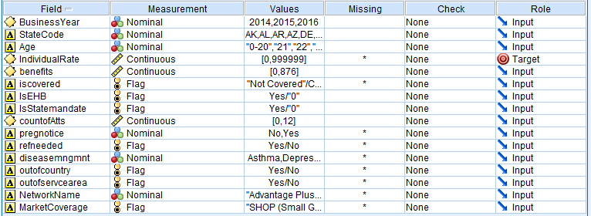
DATA SET – CLEAN / TRANSFORM / MERGE

Slide 8
MODELLING
Preliminary choice - Neural Network.
The results didn’t mention any clear insights about the fields that could impact the insurance plan types or health care spending.
The predictor importance results came out to be around 22%, which was extremely low to make and observations about the patterns of the industry.
Thus, due to the black box nature of the Neural network, an alternative choice of KNN ( K- Nearest Neighbors) to used.

Slide 9
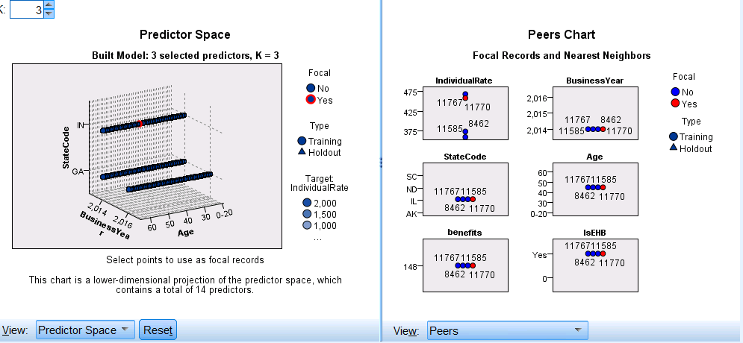
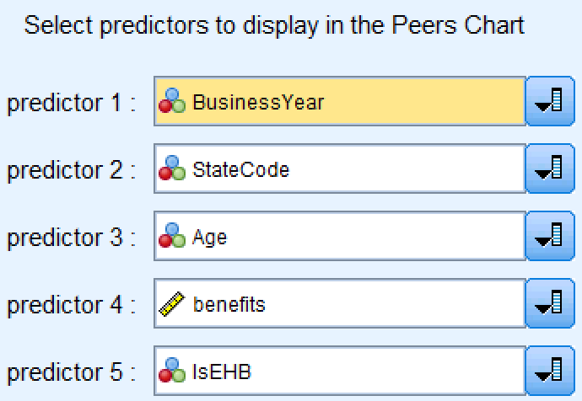
RESULTS

Slide 10
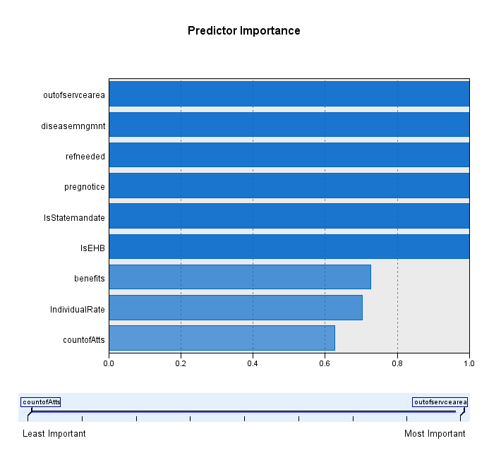
RESULTS
Predictor Importance – The major fields that had high importance in prediction were as follows:
High Factors - Out of service area coverage (Most Important) , Disease management, Reference needed, Pregnant Notice, Is Statemandate, IsEHB
Low Factors – Benefits, Individual Rate, Count of Attributes
Parameters Partition: 60 training: 40 testing
K: Minimum of 3 : Maximum of 5

Slide 11
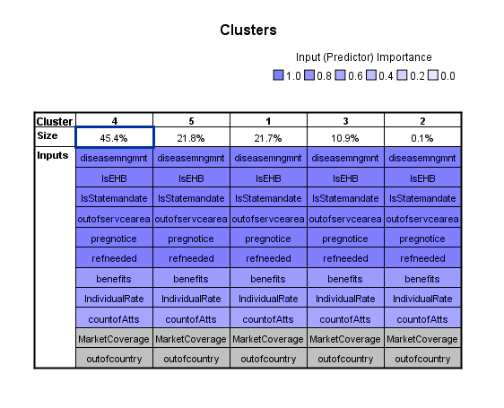
CLUSTER ANALYSIS
Disease Management proved to be the most important element in the clusters, specifically the benefit related to Asthma.
The fourth element confirms the importance of the out of service area coverage to the individual rate.

Slide 12
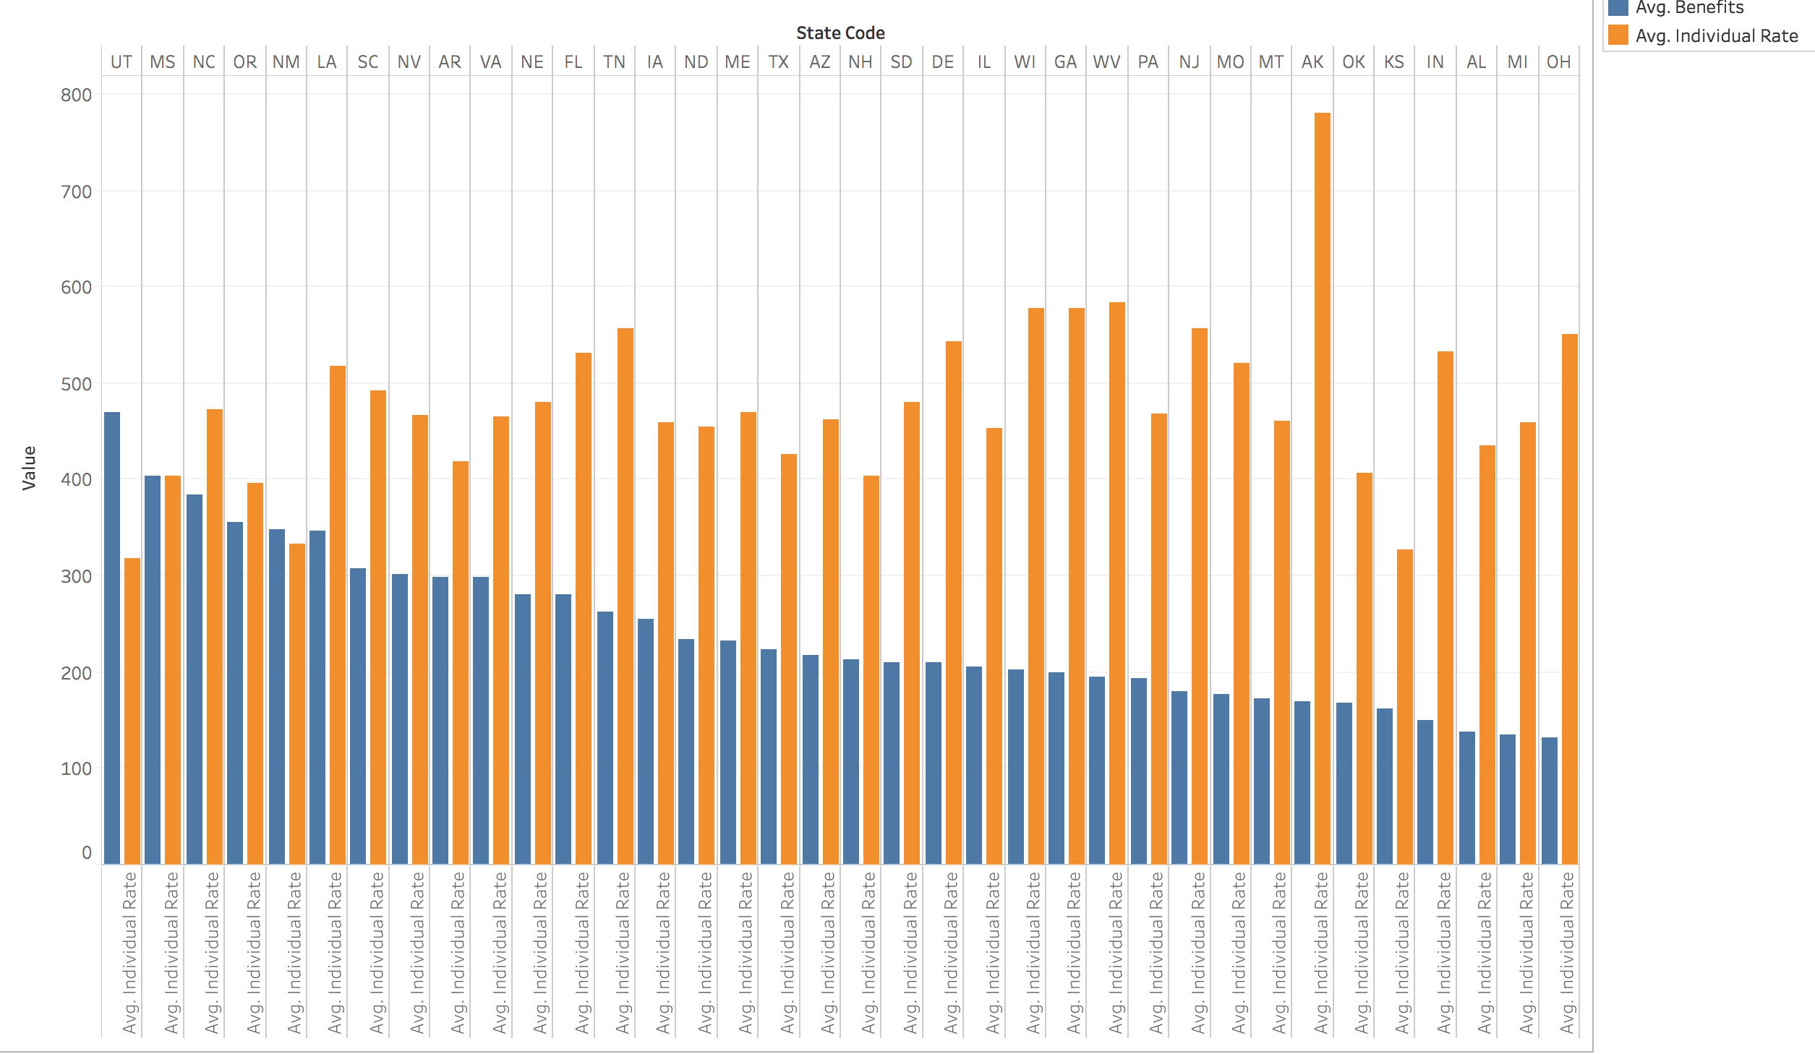
RESULTS
The individual rates are inversely proportional to the Benefits.

Slide 13
OBSERVATIONS / RECOMMENDATIONS
Based on the results, our observations are as follows:
Small Business owners and business owners in general do have options in regards to minimizing their Affordable Care Act burden. Below are three options based on our findings;
Only offer employees local coverage. Out of service area coverage proved to have the biggest impact on individual rate. This reduction in cost could greatly reduce the health insurance cost for businesses of all sizes.
Relocate to Utah, Mississippi, New Mexico, Oregon, or North Carolina. These states offer the best cost to benefit ratio for employers and individuals.
  The individual rates are inversely proportional to the Benefits.
  The Highest Individual Rate was from Arkansas and Maximum Benefits were from Utah states respectively.

Slide 14
THANK YOU

